Slide 1
AI Injury Risk Co-Pilot
Jared Nusink • COMP 4449 • March 2026
Predicting Short-Term Injury Risk from Workload & Hip Mobility

Slide 2
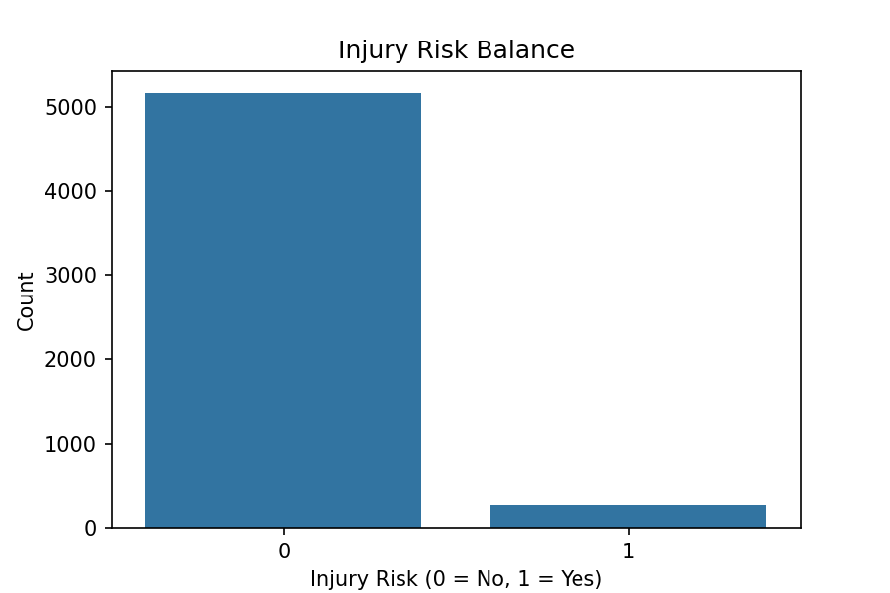
The Problem
Sports injuries cost $20B+ annually
Coaches rely on subjective judgment
Tools don't integrate workload + mobility
ML models rarely deployed

Slide 3
The Solution
Training load metrics (session-RPE, ACWR)
Hip mobility assessments
XGBoost machine learning model (AUC 0.83)
Deployed Streamlit app with safety overrides
An AI Co-Pilot that predicts injury risk in the next 7 days using:

Slide 4
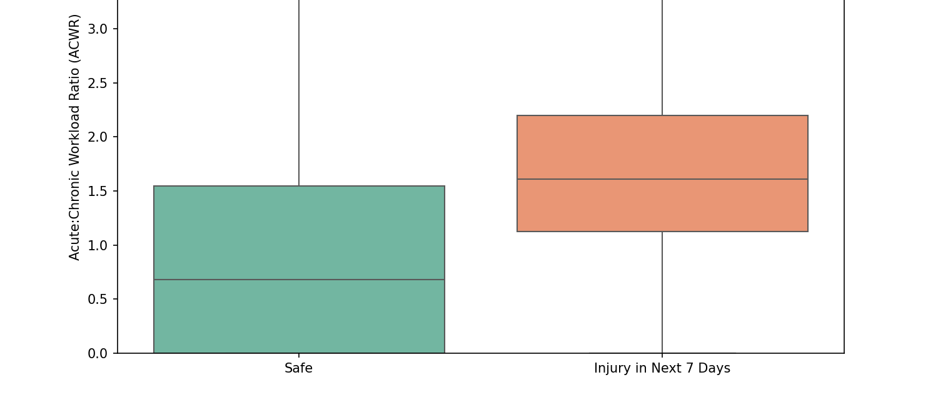
Evidence: ACWR Spikes Precede Injury

Slide 5
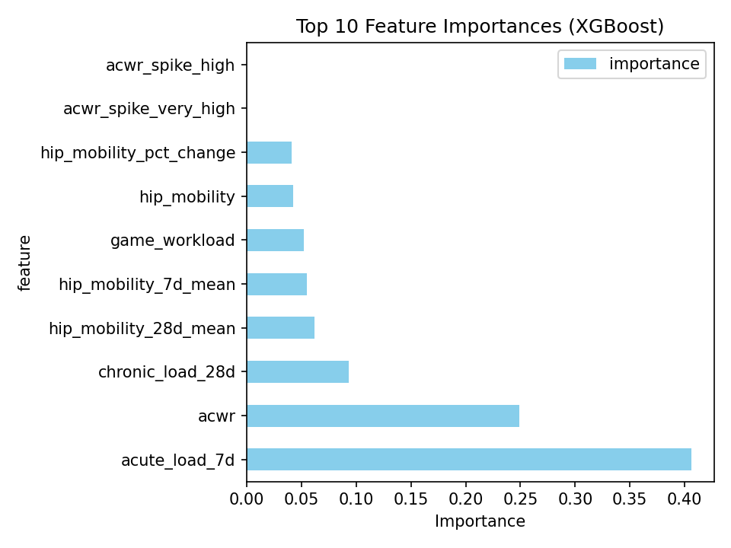
Top Predictors

Slide 6
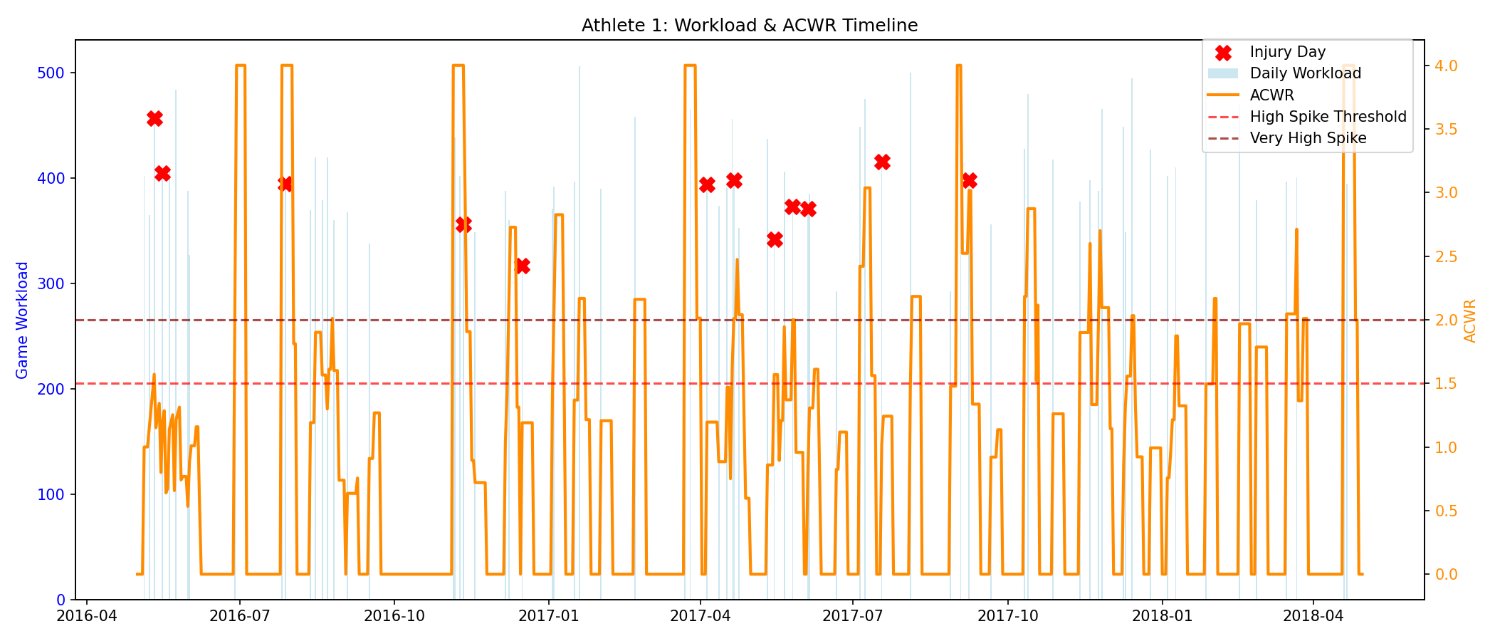
Workload Spikes → Injury

Slide 7
Model Performance
0.83
AUC Score
Strong discrimination between high-risk and low-risk days on held-out temporal validation

Slide 8
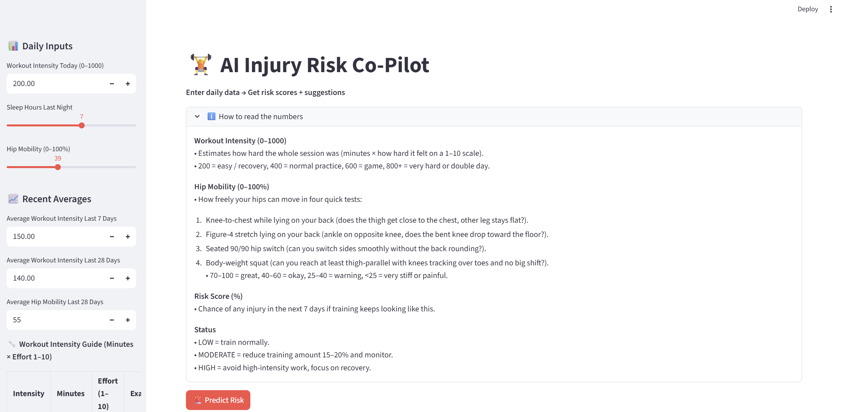
AI Co-Pilot - Live Interface

Slide 9
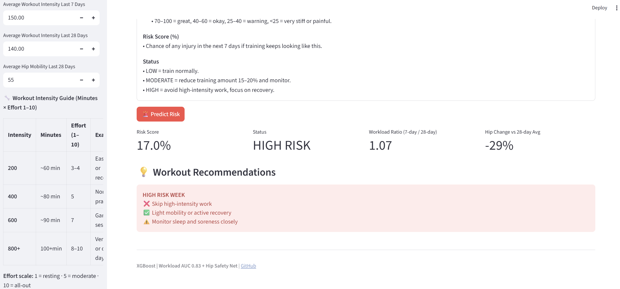
Risk Assessment & Recommendations

Slide 10
Safety Overrides
Hip Crisis
Mobility <25% or drops >60% → Force HIGH risk
Load Streak
Workload >600 + 7-day avg >450 → Elevate risk

Slide 11
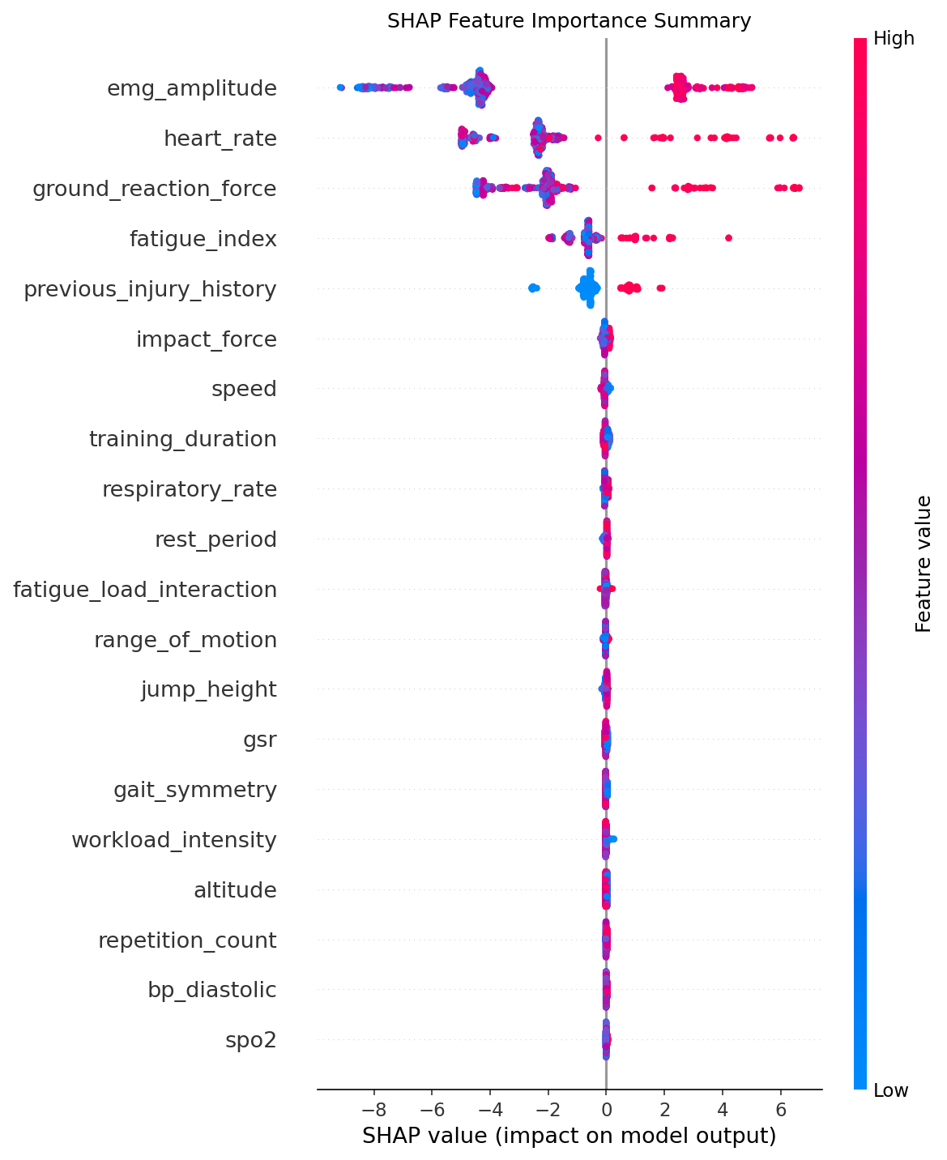
Impact & Contributions
Bridges ML research and practical tools
Combines predictions + clinical rules
Actionable recommendations, not probabilities

Slide 12
Limitations
Limited to specific athlete population
Subjective inputs (RPE, hip mobility)
Omits history, position, demographics
Requires ongoing validation and refinement

Slide 13
Future Directions
Add sleep quality, nutrition, prior injury history
Personalized baselines per athlete
Mobile app for real-time team monitoring
External validation across sports and levels

Slide 14
Thank You!
Questions?
github.com/JNusink/athlete-injury-workload-prediction

